Slide 1
Portfolio Project
Mitchell Guthmann | T1A2

Slide 2
Components
Tech Stack
Features
HTML
CSS
Javascript (responsive nav menu)
GitPages (deployed website)
Parallax images – wanted to try something different.
Responsive Nav Bar – Changes based on screen max-width
Flexbox – Keep content together with reposnsive design

Slide 3
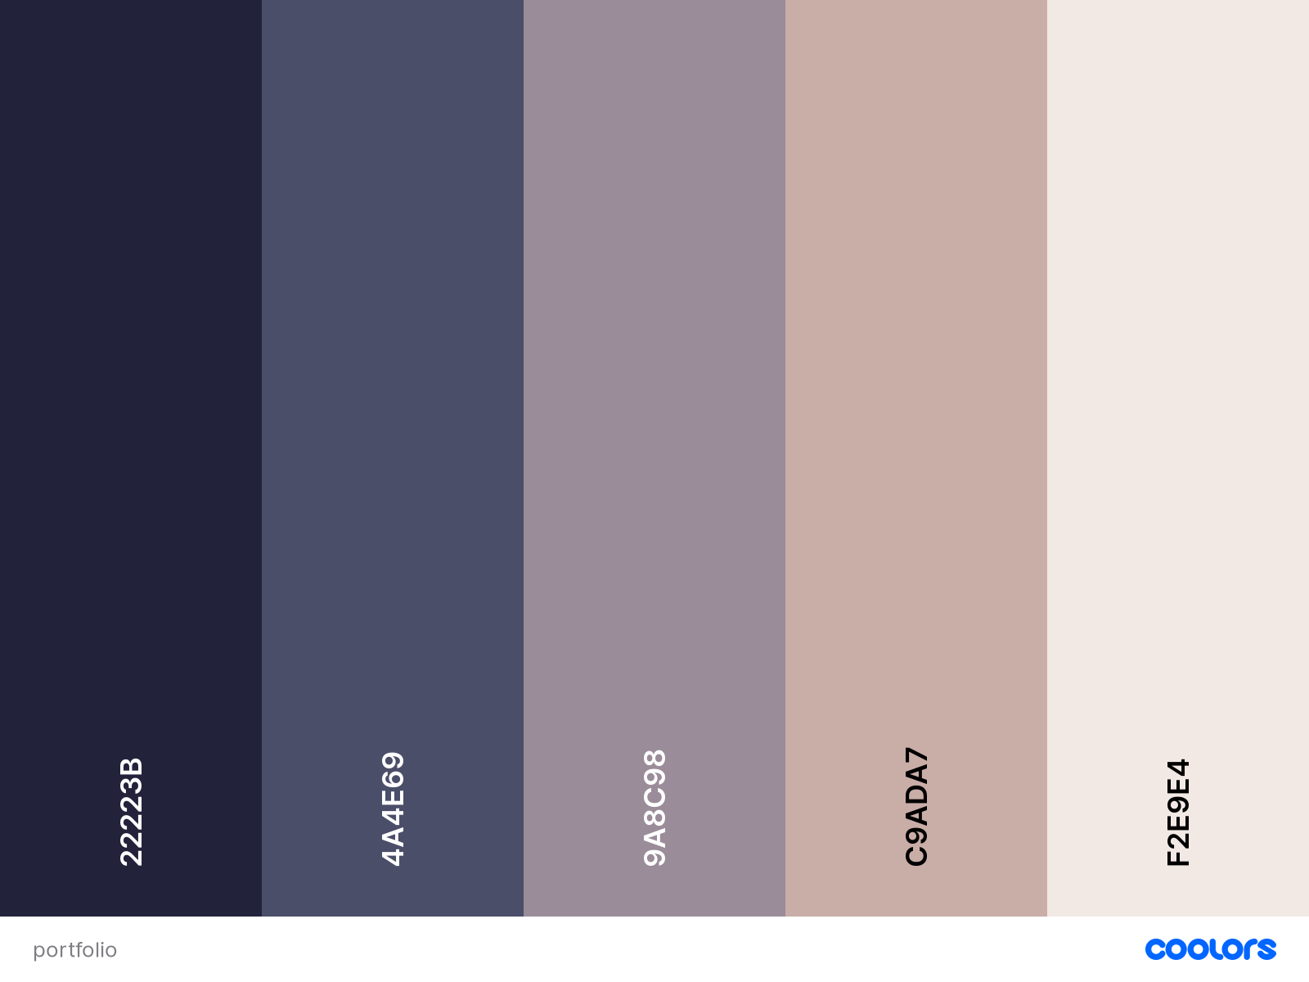
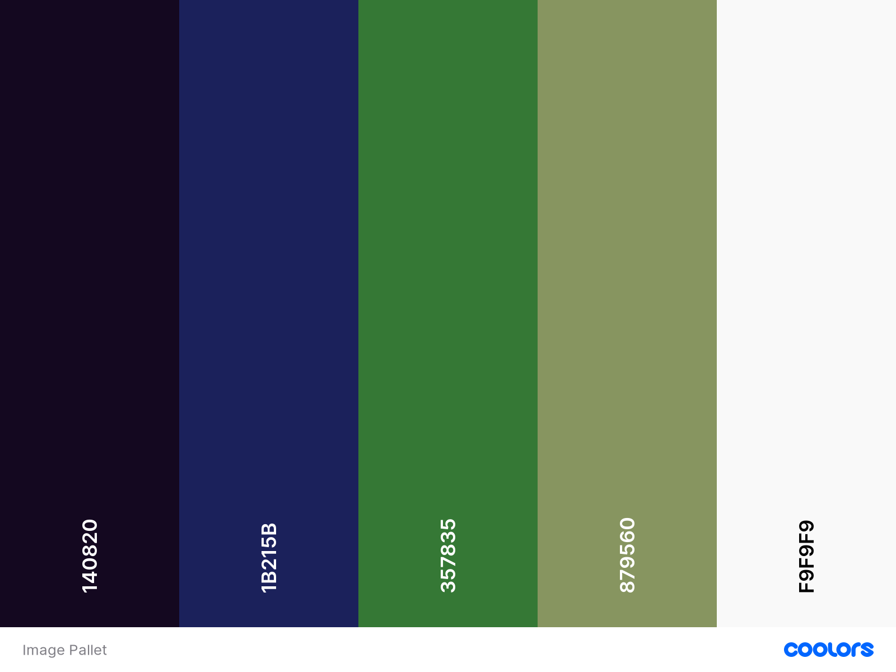
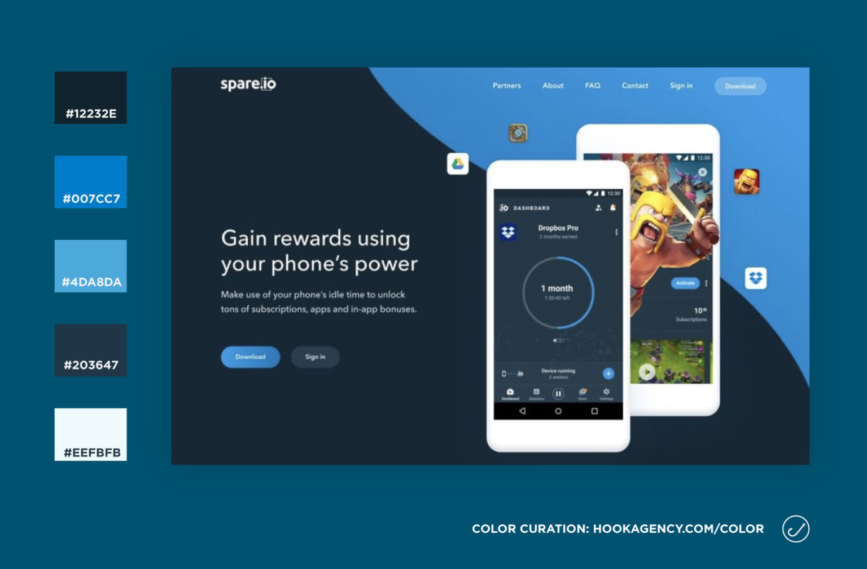
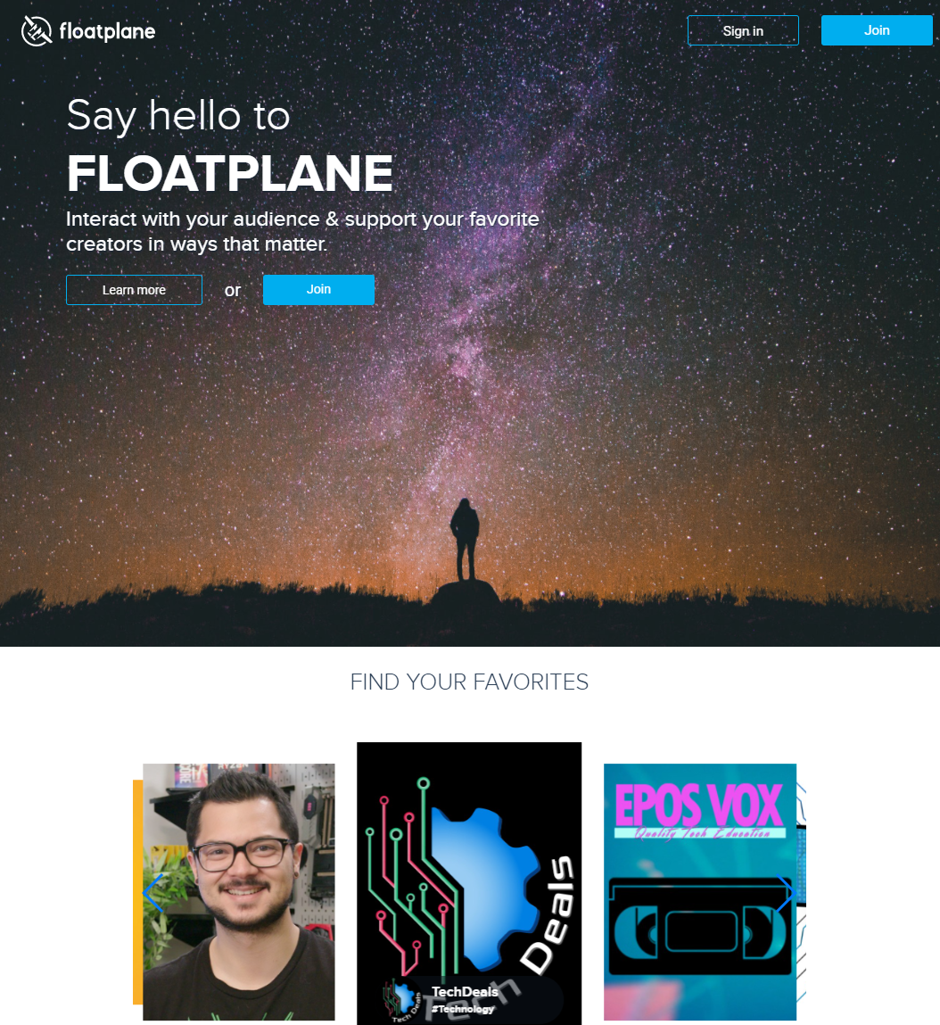
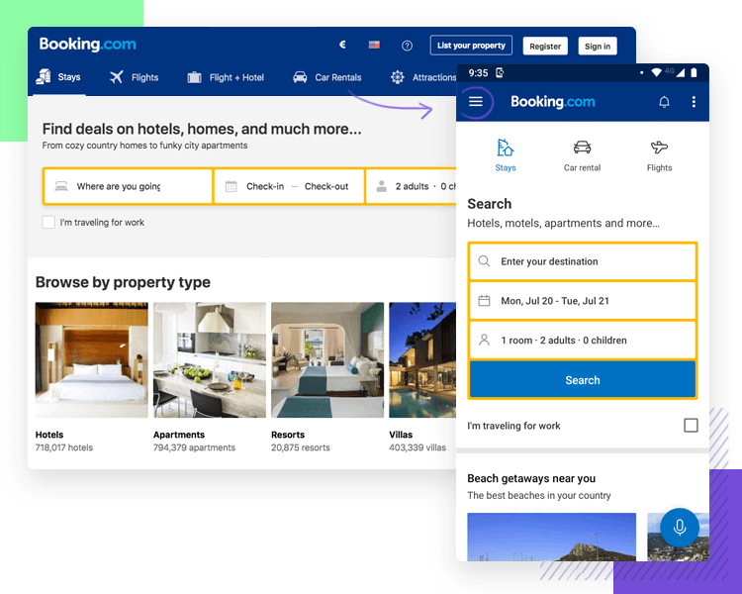
Design and Inspiration
Colour Pallet:
Uniform colour across the whole site.
Design Features
Parallax scrolling images
Responsive burger menu

Slide 4
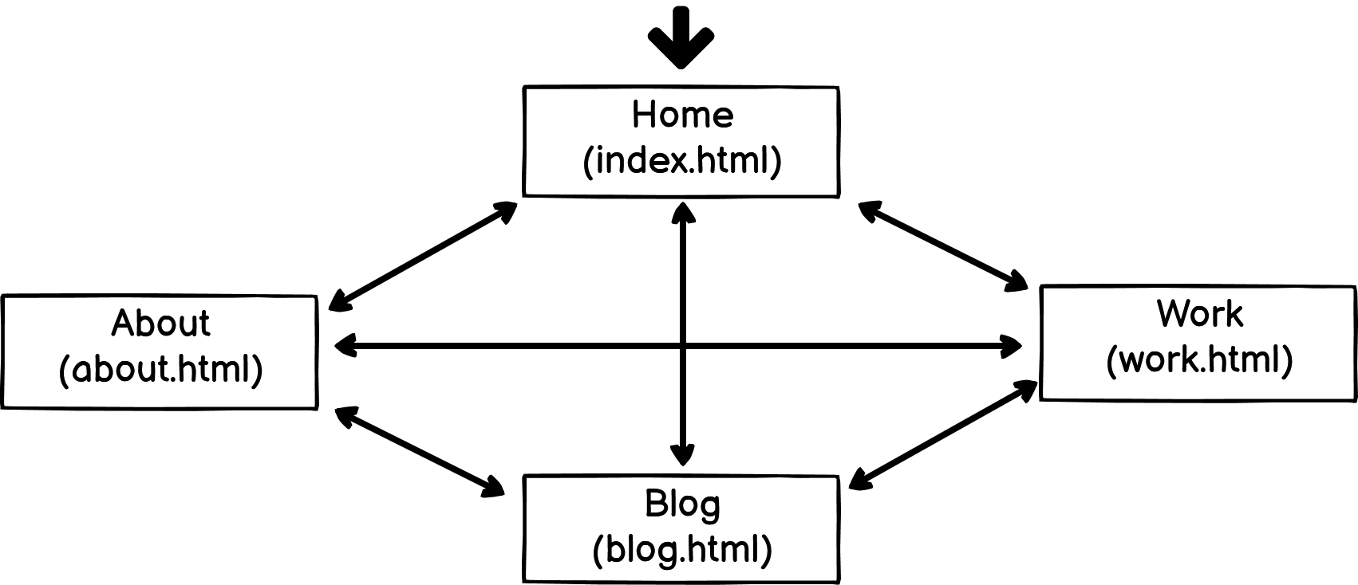
Sitemap
Opens on index.html
All pages can navigate to each other via the Nav Bar.
All footers include links to Linkedin & Github.

Slide 5
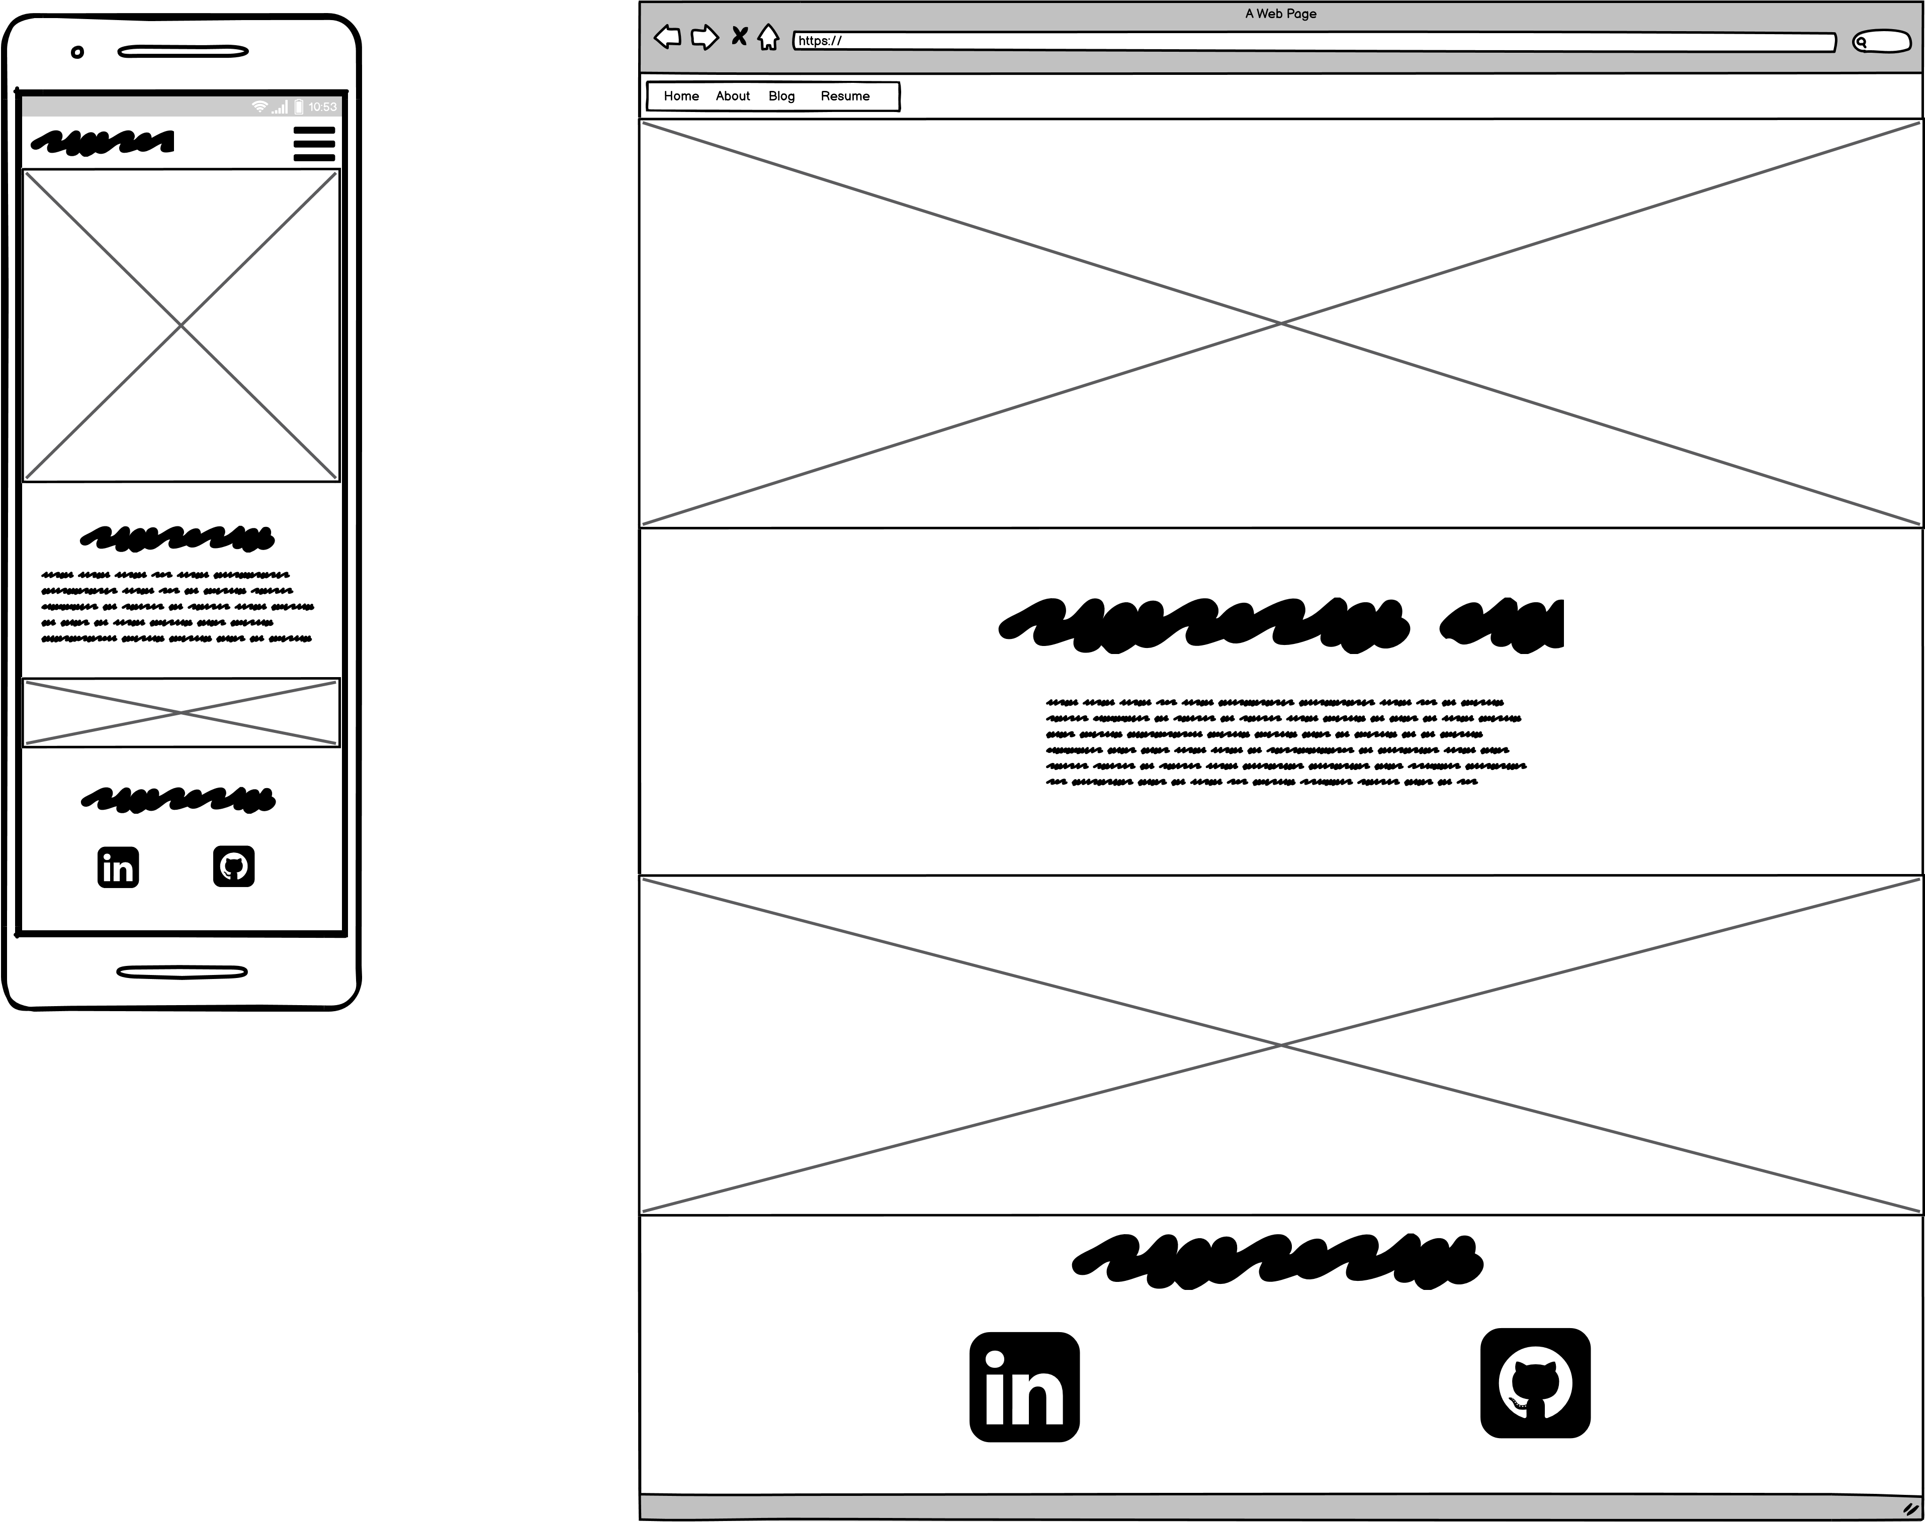
Wireframes Home
Landing page for the site.
Not too much information given here, but easy to access other pages

Slide 6
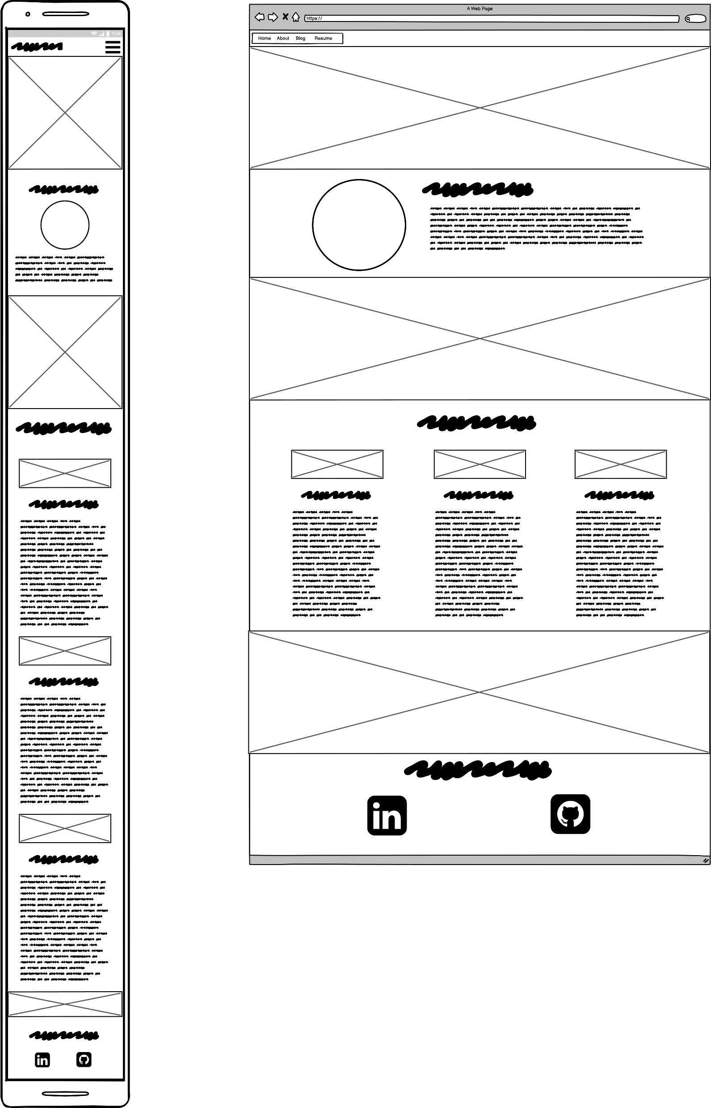
Wireframes About
To be filled with a blurb on myself, and a section on my interests.
Flex wrap used to align image and blurb vertical on mobile screens.
Interests columns also wrap, however have fixed widths?

Slide 7
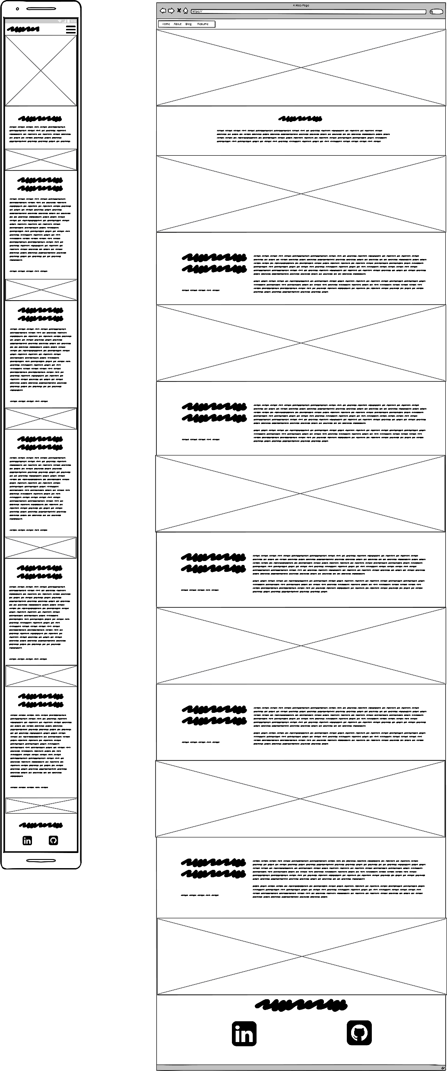
Wireframes Blog
Parallax images used for separating posts.
Flex used to keep titles on the left on desktop.

Slide 8
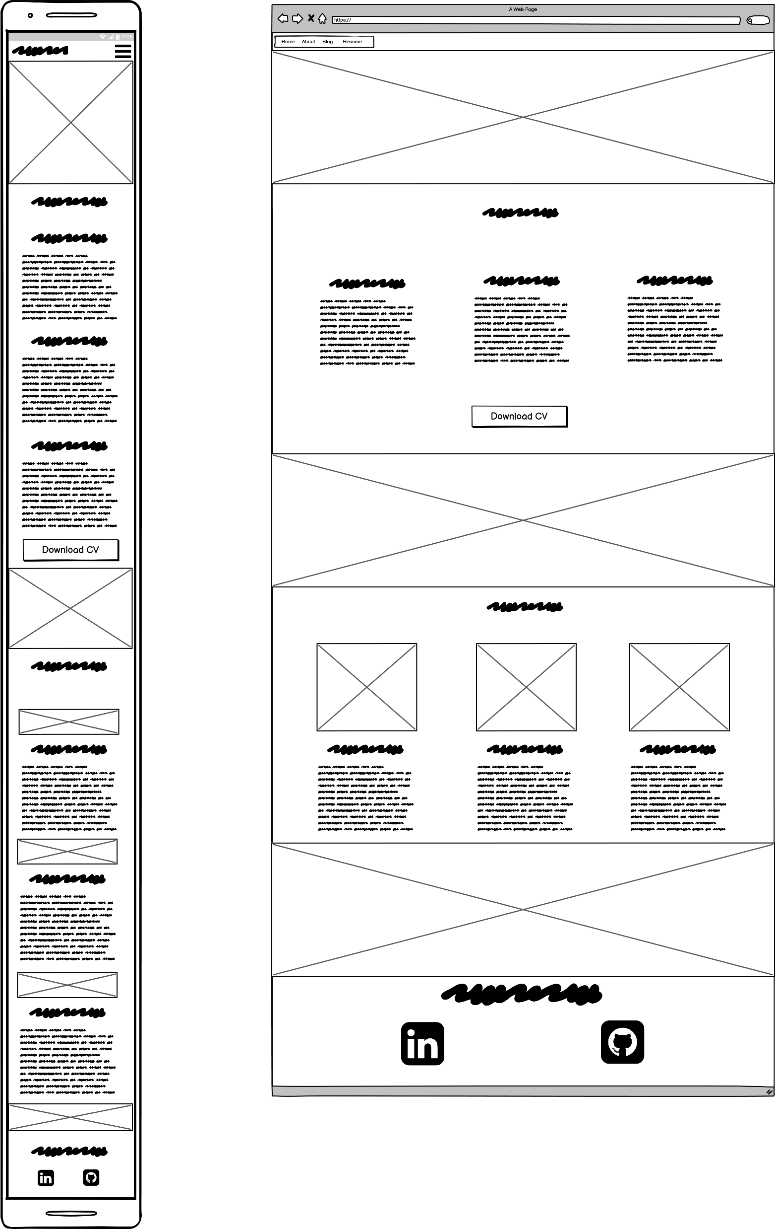
Wireframes Work
2 lot of flex columns, wrap in mobile.
Download button for CV
Top half to provide work experience, lower half to show projects worked on.
Content heavy page, would look at separating in future.

Slide 9
Personal Review
Challenges I faced
Colour Pallet – took to long to pick one
Parallax images
Relied on CSS – needs an alt tag
Overused them across the site?
Fought against this most of the time.
What I’ve learned
Start with a foundation first, work on features later.
Clean up your code.
K.I.S.S

